Slide 1
Eliminating technical debt in Digital Humanities projects
Janelle Jenstad and Martin Holmes University of Victoria Humanities Computing and Media Centre

Slide 2
Outline
Who we are and what we do
What we used to do 20+ years ago
The advent of exciting new tools
Problems with the new approach:
Sporadic/partial publication with missing dependencies
Uncitability
Maintenance burden and security risks (Tamagotchi projects)
We were thinking like software devs. How about thinking like humanists?
How book editions have worked for centuries (Speculum pecatris)
How can we use this model for digital editions? (Pet rock projects)
Endings principles.
Everything we gain.

Slide 3
What is HCMC?
Set up in the mid-1990s​
Provides programming support for research and teaching in the Humanities​
Has published hundreds of digital resources over the years​
Many of these are large-scale digital editions, such as:​
The Map of Early Modern London (13,257 pages, mapoflondon.uvic.ca)​
The Colonial Despatches of BC and Vancouver Island (10,827 pages, bcgenesis.uvic.ca)​
The Landscapes of Injustice Archive (154,846 pages, loi.uvic.ca/archive)​

Slide 4
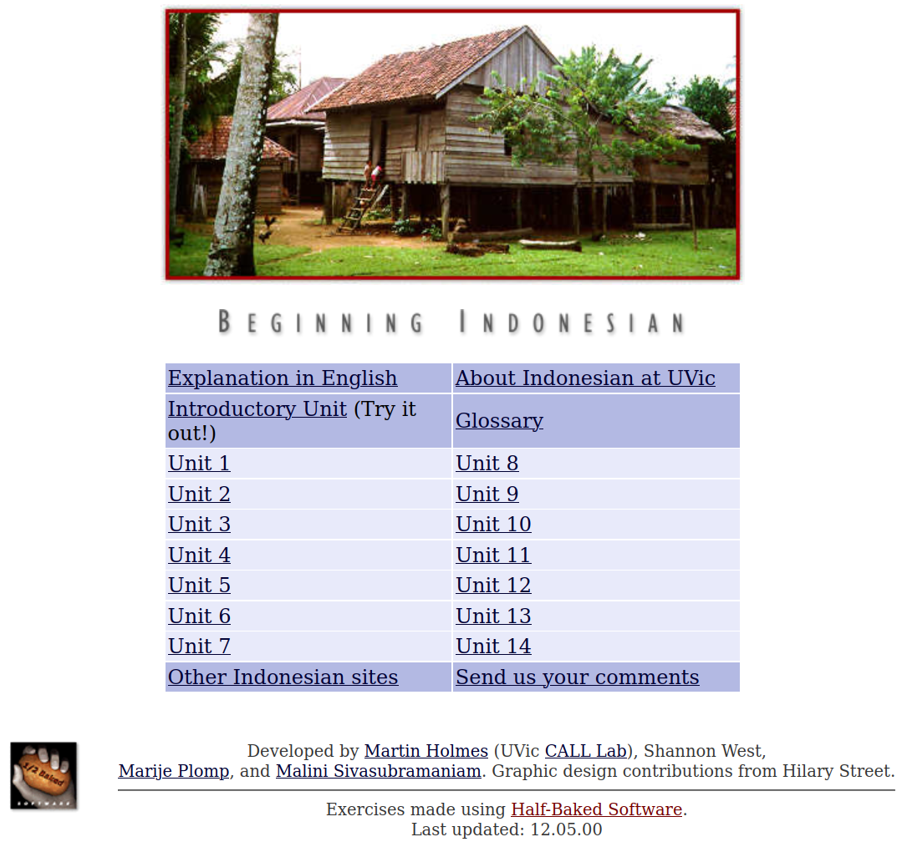
The 1990s
We made websites mostly to support language teaching.​
We build lots of interactive exercises using HTML, CSS and JavaScript.​
Most of these sites have never been updated – see for example:​
web.uvic.ca/hrd/indonesian/​

Slide 5
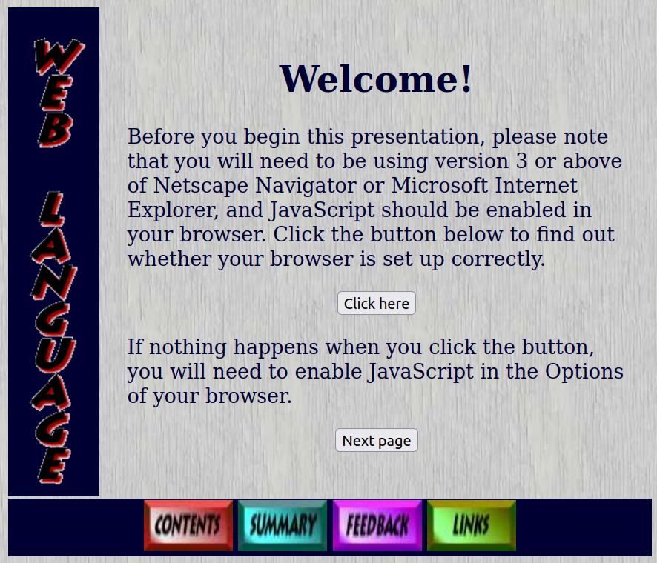
The 1990s
These sites all still work – even though they look SOOO 1990s:​
web.uvic.ca/lancenrd/martin/weblang/
No maintenance burden from these sites!

Slide 6
The early 2000s
Digital Humanities became a thing.
New technologies came along.
We got ambitious and enthusiastic, and started building larger, more complex sites with:
ASP
MySQL, PostgreSQL, PHP
Apache Cocoon
The eXist XML database
...and lots of other cool new tools.​

Slide 7
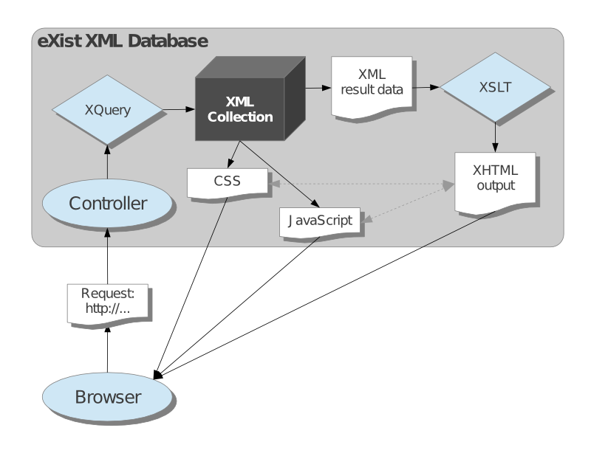

Slide 8
Apparent advantages of this sort of stack
​Changes to output rendering propagate instantly to the whole collection.
Individual documents can be published as soon as they’re ready (“rolling publication”).

Slide 9
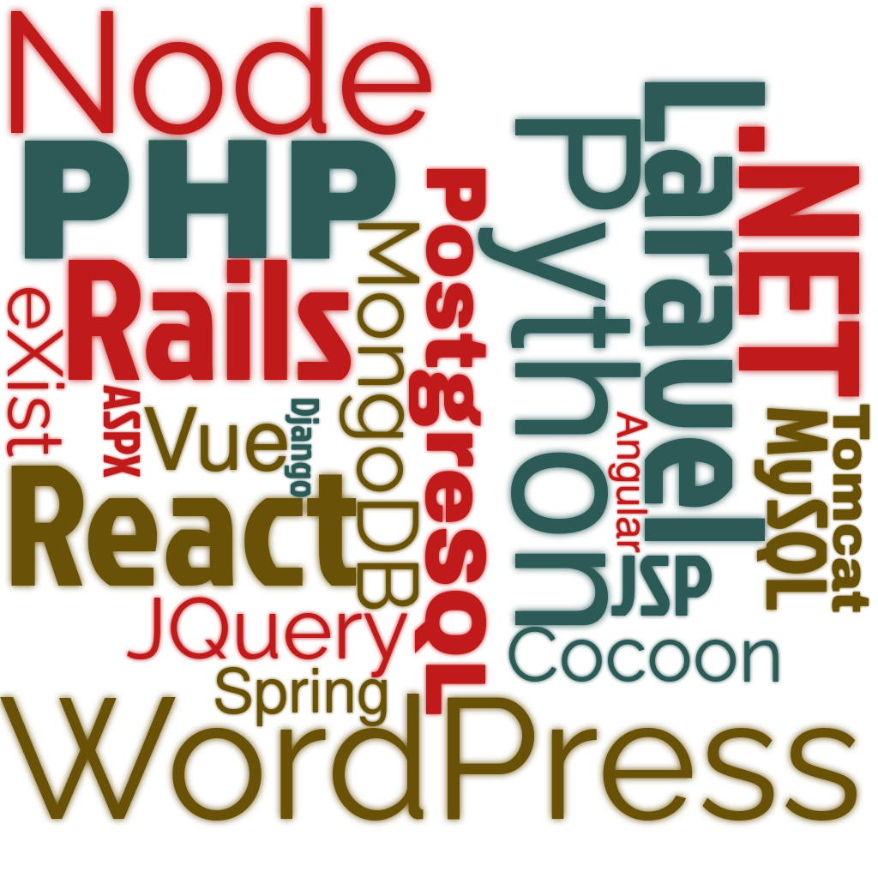
BUT: Horrible technical debt

Slide 10

BUT: Horrible technical debt
Update Java: Tomcat breaks.
Update Tomcat: Cocoon breaks.
Update Cocoon: eXist breaks.
Update eXist: XQuery has to be
rewritten.
...
OS update requires MySQL update.
MySQL update requires PHP update.
PHP update requires code rewrite.
...

Slide 11

Now every project is a Tamagotchi.
Life is nothing but maintenance.
There’s no time for new projects.

Slide 12
But wait – it’s worse. Remember this?
Individual documents can be published as soon as they’re ready (“rolling publication”).
It seemed like a good idea at the time...

Slide 13
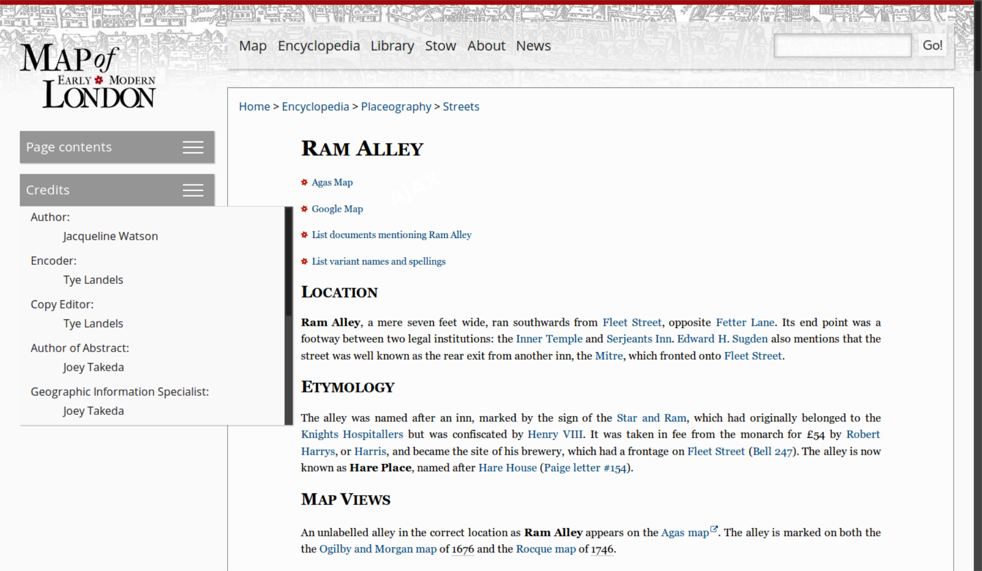
The trouble is, there’s no such thing as a document.

Slide 14
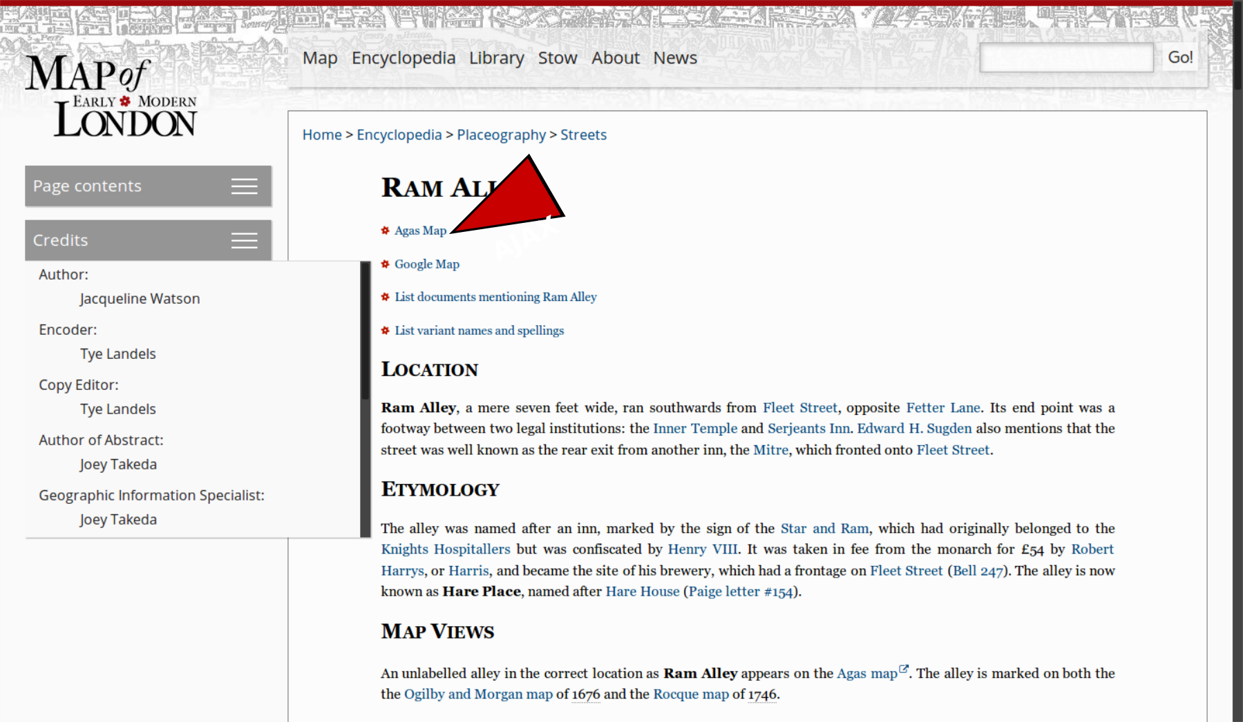
The trouble is, there’s no such thing as a document.

Slide 15
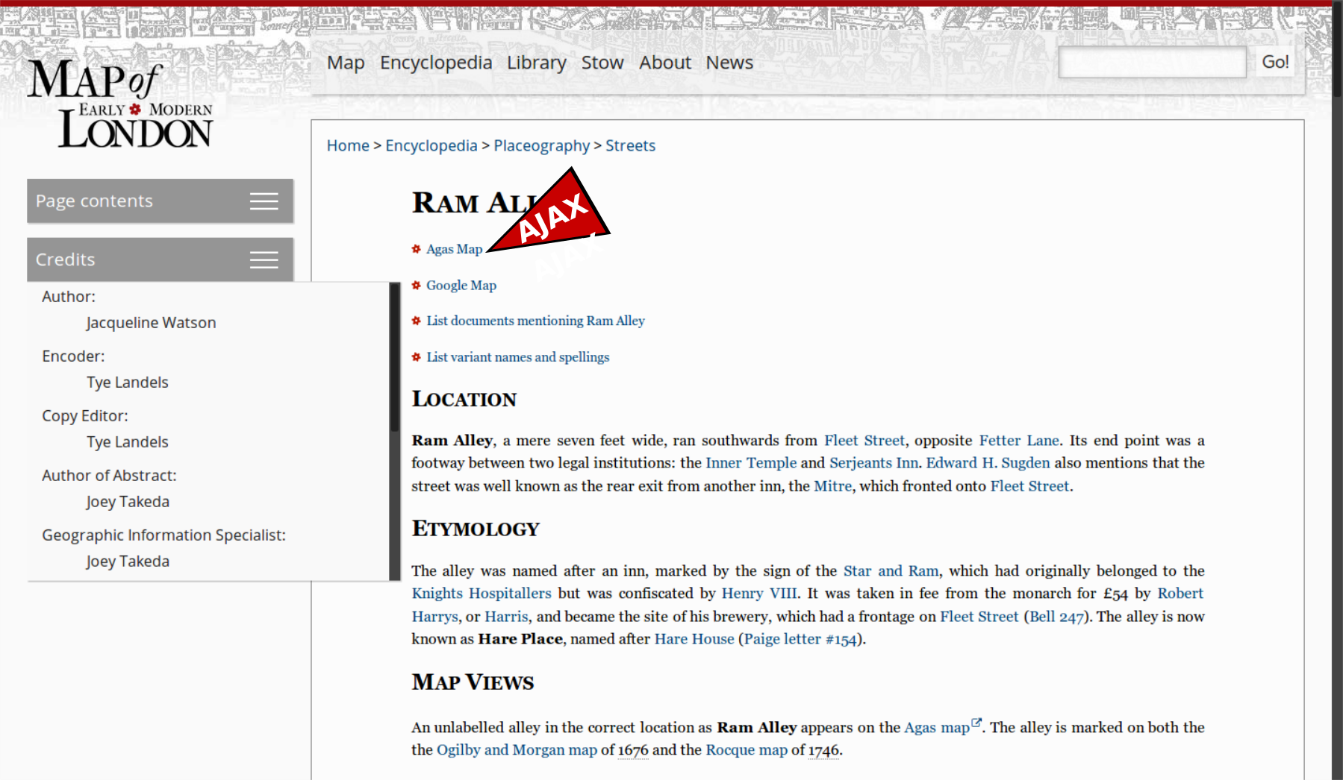
The trouble is, there’s no such thing as a document.

Slide 16
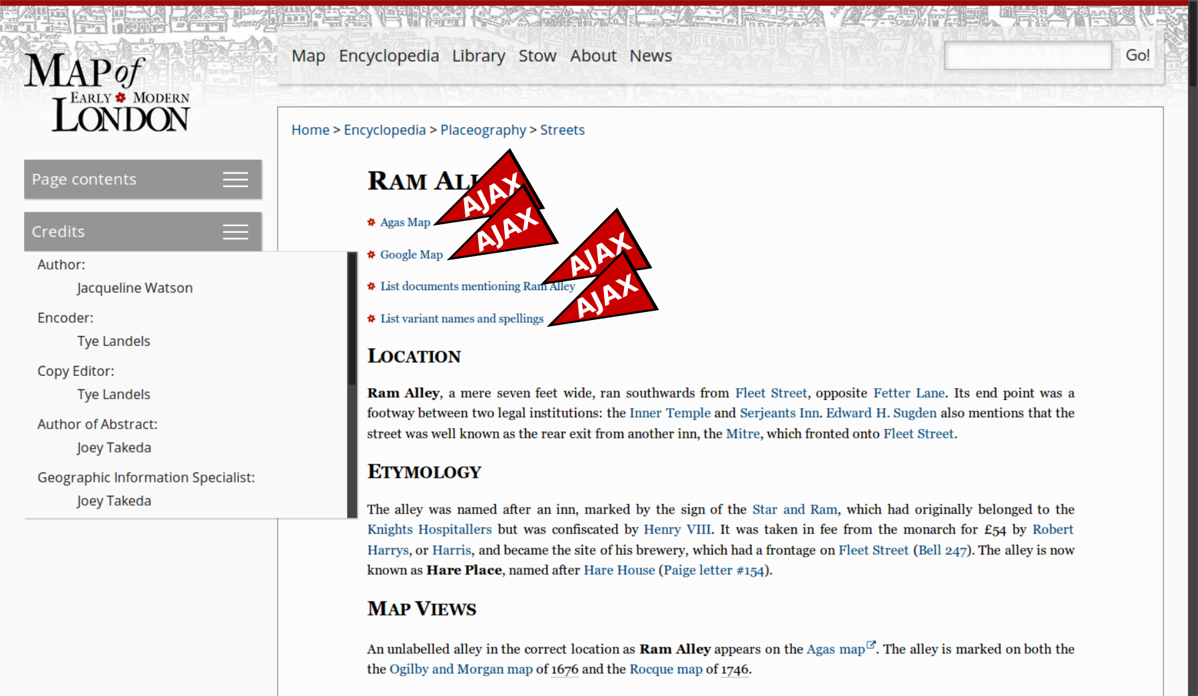
The trouble is, there’s no such thing as a document.

Slide 17
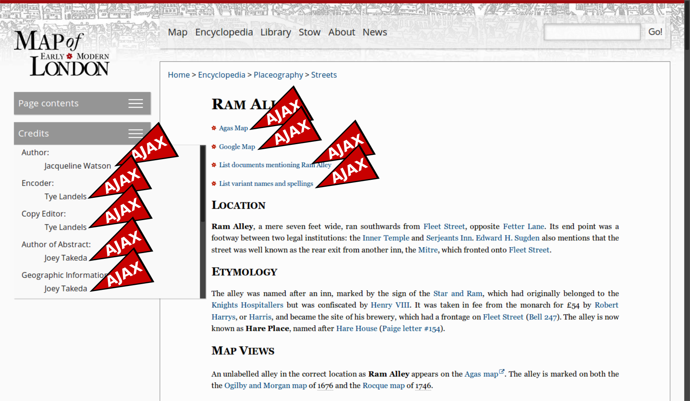
The trouble is, there’s no such thing as a document.

Slide 18
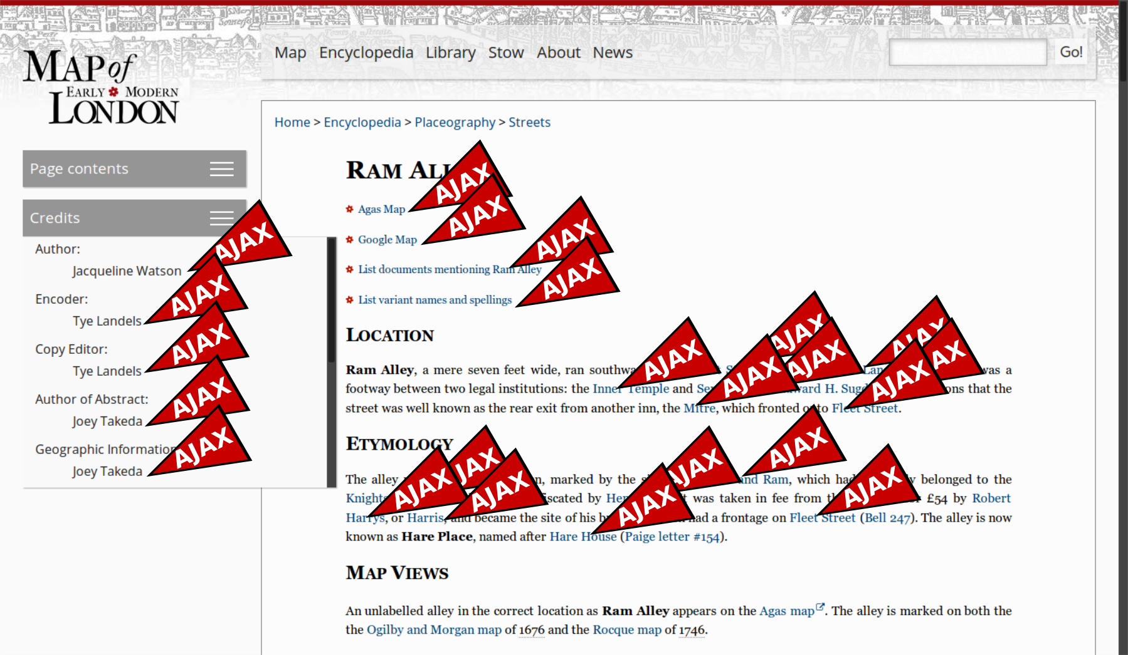
The trouble is, there’s no such thing as a document.

Slide 19
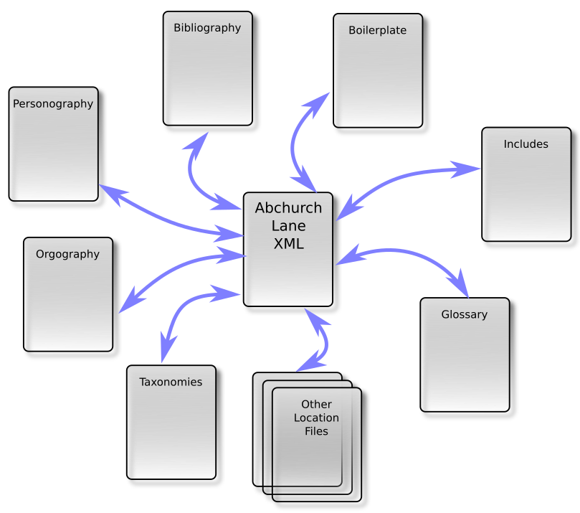
A digital edition is a network, not a collection of discrete docs

Slide 20
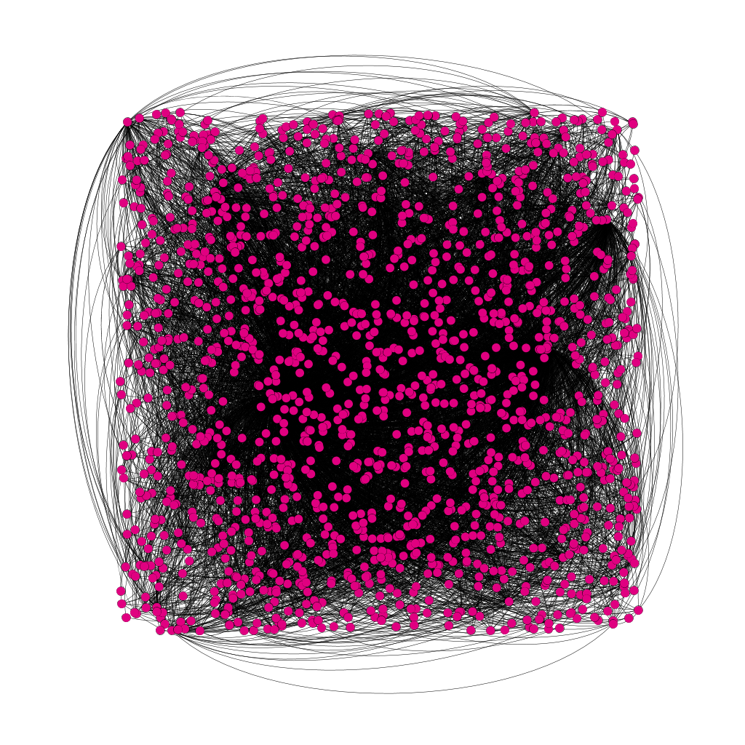
Network map of MoEML

Slide 21
The scholarly corollary:
​Changes to one “document” cause changes to other “documents”.
There is no reliable way to cite a “page”.
There’s no way to get back to the version of a “page” you saw last week.
So nobody will cite the project.
So the scholars involved will not win prizes/get tenure/get grant money/be happy and successful.

Slide 22
So the rolling-release technical-debt model is:
​bad for developers because they spend their lives on maintenance; and
bad for scholars because their work appears untrustworthy and uncitable.
So let’s stop thinking like software developers, and start thinking like proper humanists.

Slide 23
Justifiable Suspicion of Moving Targets
… you should never end your research with Wikipedia or another wiki. Instead, use such sites at the very beginning stages of your research to gather basic information and sources and then move on to more credible sources.
– Ellen C. Carillo, MLA Guide to Digital Literacy, 104
Notes:
Mention the WikiBooks edition of The Devonshire Manuscript.

Slide 24
Even Wikipedia won’t cite Wikipedia
Wikipedia is not a reliable source for citations elsewhere on Wikipedia. As a user-generated source, it can be edited by anyone at any time, and any information it contains at a particular time could be vandalism, a work in progress, or simply incorrect.
https://en.wikipedia.org/wiki/Wikipedia:Wikipedia_is_not_a_reliable_source

Slide 25
We claim …
Style guides won’t help us cite a moving target.
The onus is on producers of resources, not citers of resources.
The digital resources themselves need to move to stable versioning/editioning.

Slide 26
What books got right
German Edition (1537)
Dutch editie (1546)
English edition (1556)
Italian edizione (1575)
Portuguese edição (1666)

Slide 27
“edition”
Edmund Coote, The English Schoolmaster (1596): “putting forth”
John Florio, A World of Words (1598): “a setting foorth, a publishing, a creating or an edition”
Robert Cawdrey, A Table Alphabetical (1604): a “putting fourth, setting abroade”

Slide 28
Edition as text
A printed version of a given work that may be distinguished from other versions … by its membership of a complete batch of copies printed from the same setting of type, usually at the same time and place. These batches come to be numbered as first, second, third, etc. editions, each time a new version is set again from fresh type.
- Baldick, Oxford Dictionary of Literary Terms

Slide 29
New Edition as New Text
I haue now in this seconde edition taken about it such paines, yt verye fewe great faultes & notable errours are in it to be founde.
– Ralphe Robynson,
second edition of
his translation of
Thomas More’s Utopia, 1556 (A3v)

Slide 30
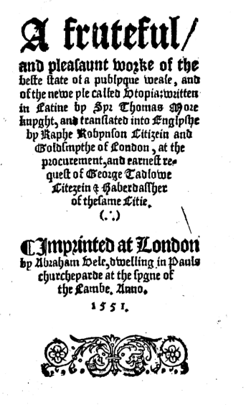
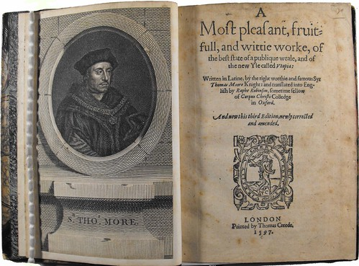
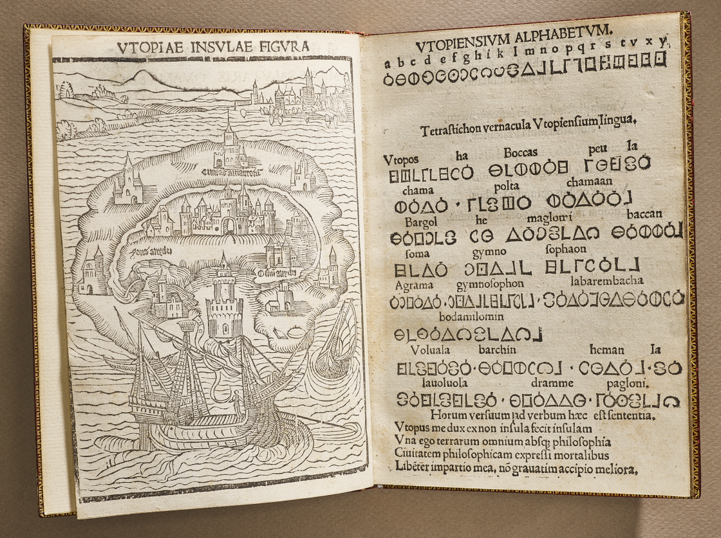
Notes:
1516 (NYPL), 1551, 1556

Slide 31
Edition as format
A printed version of a given work that may be distinguished from other versions … by its published format (e.g. paperback edition, popular edition, abridged edition)
– Baldick, Oxford Dictionary of Literary Terms

Slide 32
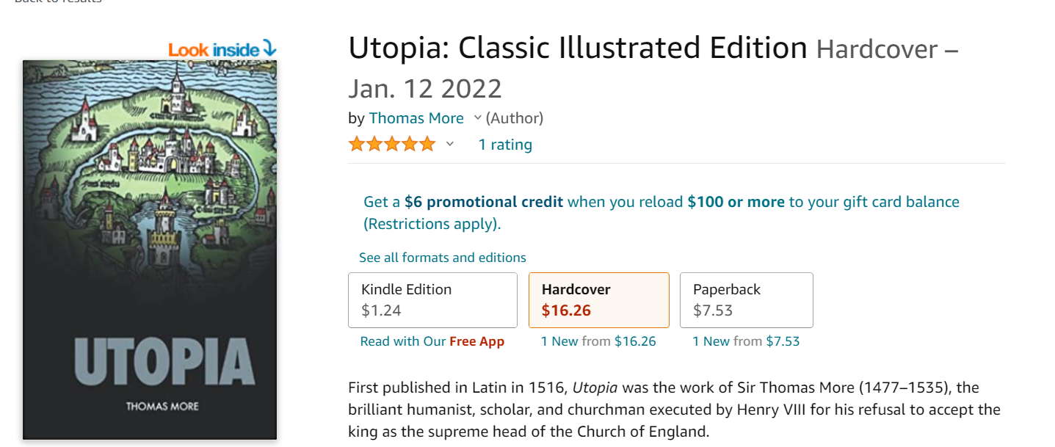
Confusing uses of “edition”
Paperback edition
Hardcover edition
Kindle edition
Audiobook edition
Classic illustrated edition (available in Kindle edition)

Slide 33
Edition as Textual Critical Production
The term is also applied rather differently to the works of an author as edited by a particular scholar or by a team of scholars sharing the same procedures.
– Baldick, Oxford Dictionary of Literary Terms

Slide 34
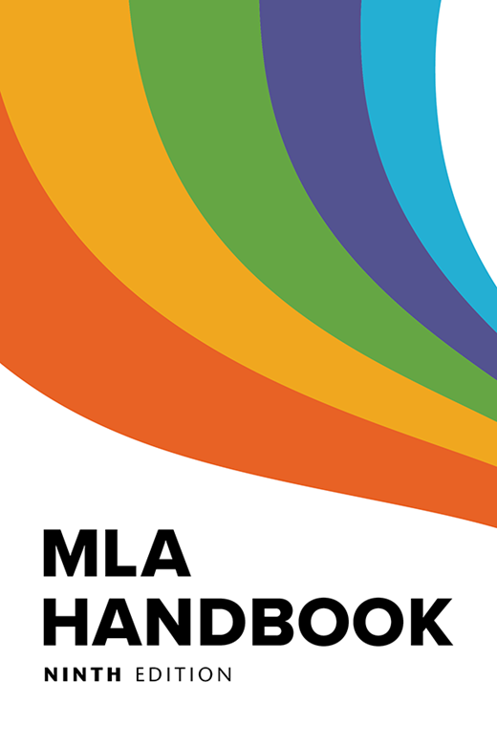
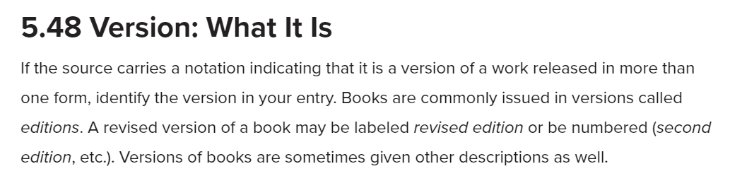
Convergence of Editions and Versions
Notes:
Hand over to Martin at the end of this slide.

Slide 35
Endings Principles 5: Release Management
Release management handles the public release of products. Without good release management, a project can never end gracefully; it can only falter and die.
– https://endings.uvic.ca/principles.html#release-management

Slide 36
5.1 Releases should be periodic and carefully planned.

Slide 37
5.2 A release should only be made when the entire product set is coherent, consistent, and complete (passing all validation and diagnostic tests).
Notes:
e.g., all documents are “published,” all content is “complete”

Slide 38
5.3 Like editions of print works, each release of a web resource should be clearly identified on every page by its build date and some kind of version number.

Slide 39

How MoEML does it
MoEML footer:

Slide 40
MoEML v.7.0, svn rev. 20565 2022-05-05 09:11:13 -0700 (Thu, 05 May 2022).
Notes:
svn rev = “same setting of type”?

Slide 41
5.4 Web resources should include detailed instructions for citation, so that end-users can unambiguously cite a specific page from a specific edition.

Slide 42
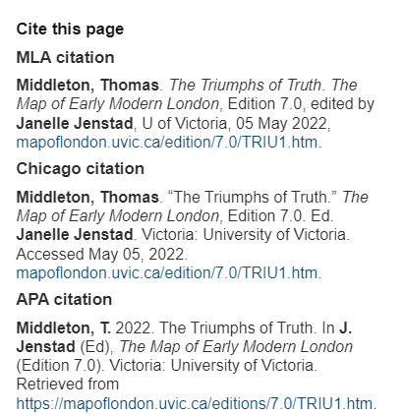

Slide 43
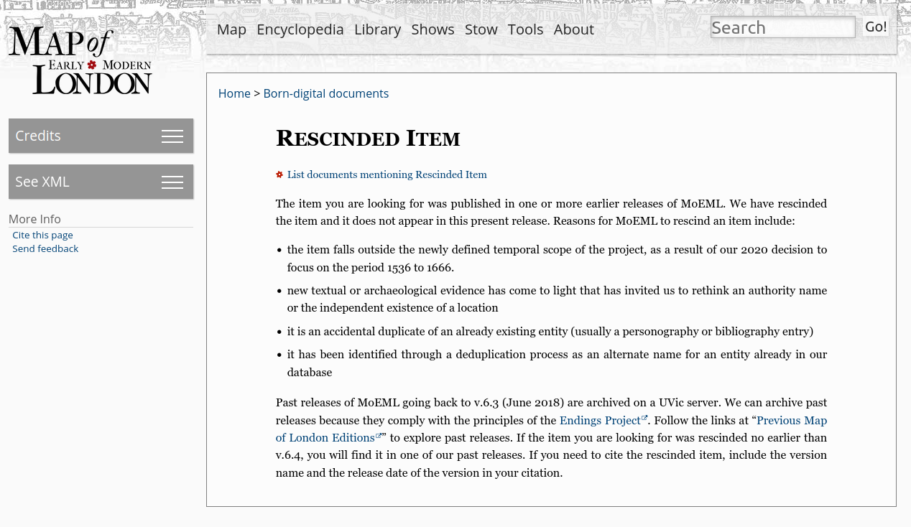
5.5 URLs for individual resources within a digital publication should persist across editions. Any moved, retired, or deleted resources no longer available at a previously accessible URL should be redirected appropriately.

Slide 44
We want lots of static copies.
Another desirable feature of the book is its durability.
Books are durable partly because they’re multiple and scattered.
We need to do the same with a digital edition – make lots of copies.
It’s hard to make lots of copies of a complex database-driven infrastructure.
Therefore we need our digital editions to be simple, static, portable, and easily copied.

Slide 45
What is a static site?
What we release: a static, numbered edition with no server-side dependencies
HTML, JavaScript and CSS: every page is built at the same time in a single operation from a single source dataset.
You can put it on thumb drives and distribute them to run on any web server.
You can download it as a ZIP file and install it on many machines.
The copy we host at the UVic URL is the canonical copy but it’s just ONE of many static copies (like the public library copy).

Slide 46
We need to be able to cite digital editions with the same precision and reliability as print editions.
We need cited materials to persist and remain accessible.
We need to be able to archive them over the long term.
So:
We must make coherent, consistent, complete, identifiable editions, not rolling-release mutating monsters.

Slide 47
Thanks
The Endings Team: Claire Carlin, Ewa Czaykowska-Higgins, Janelle Jenstad; Stewart Arneil, Martin Holmes, Greg Newton; John Durno, Matt Huculak, Lisa Goddard; Emily Comeau and Joey Takeda
Faculty of Humanities
University of Victoria Libraries
Social Sciences and Research Council of Canada

Slide 48
Section Slide Title

